Slide 1
measure
tall
short

Slide 2
tall
short
tall
short

Slide 3
tall house
short house

Slide 4
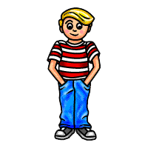
tall boy
short boy

Slide 5
tall
flower
short flower

Slide 6
Circle the tallest

Slide 7
Circle the tallest

Slide 8
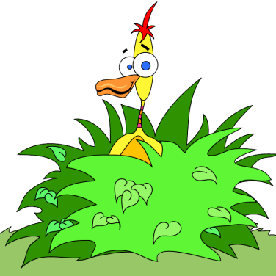
Circle the Shortest

Slide 9
Circle the Shortest

Slide 10
Circle the tallest

Slide 11
Circle the shortest

Slide 12
Draw a taller box

Slide 13
Draw a shorter box

Slide 14
put in order from shortest to tallest

Slide 15
Tallest to Shortest
Tallest
Middle
Shortest

